Slide 1
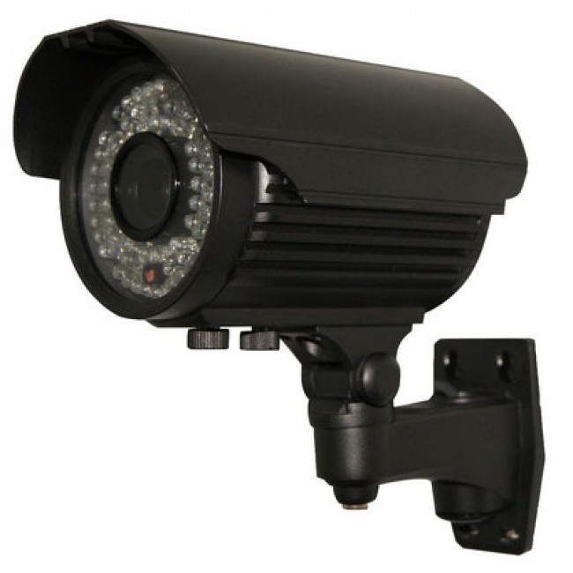
Smart Home Surviellence
- Meet Maheshwari (1620BECE30034)
- Priya Mehta (1620BECE30044)
Guide
Hitesh Patel

Slide 2

Breif !dea
Smart Home Surviellence is a system to detect and identify activites that are going on inside a House/Organisation.
It is a new and advance method used to replace current CCTV system.

Slide 3

Majourly in this world, in occurence of any crime, the first step that people do for proof is go through CCTV.
Be it in Home, on streets or in an organisation.
This takes upto a lot of time.
What is a family has a young child at home and he cannot be left unsupervised !?
Thus role of Smart CCTV comes to place where it can detect the activities and reply to the concern person about the same.

Slide 4
Technology Used
Android Jetpack
Firebase
TensorFlow

Slide 5
Why use this technology?

Slide 6

Android Jetpack
We have used CameraX API from Android Jetpack to provide seamless analysis and preview.
It reduces our efforts of coding as compared to the regular camera API
We've used WorkManager to provide with background process
We've also used DataBinding and LiveData and Room Database to provide us uninterrupted execution with UI.

Slide 7

Firebase
Firebase is a web and mobile platform to provide database, storage, authentication and ML APIs.
We've used Firebase to put our custom tensorflow model for execution on the cloud.
It helps us in interacting with the internet and also provides a scope for expansion.

Slide 8

TensorFlow
TensorFlow is a free and open-source software library for dataflow and differentiable programming across a range of tasks. It is a symbolic math library, and is also used for machine learning applications such as neural networks.
We've used TensorFlow to deploy our classification model on the Firebase.

Slide 9

In this updating world, people never have time to what is going on in their neighbourhood. Some don't even know their neighbours.
Earlier, all neighbours had an !dea of each other and took care of others belongings in thier absence.
So we need to such a system to take care of us.
And why not be SMART !!

Slide 10
What are we doing?
For an activity detection, first we need to find a pose of a person.
For pose detection, we first need to find person.
For a peron detection, first we need to find object.
•For an object detection, first we need to deploy image classification.

Slide 11
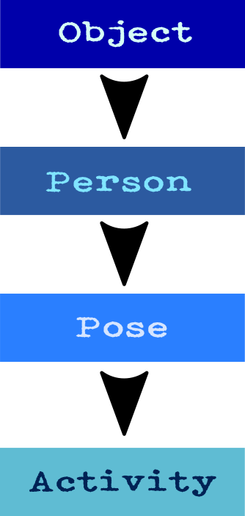

Slide 12
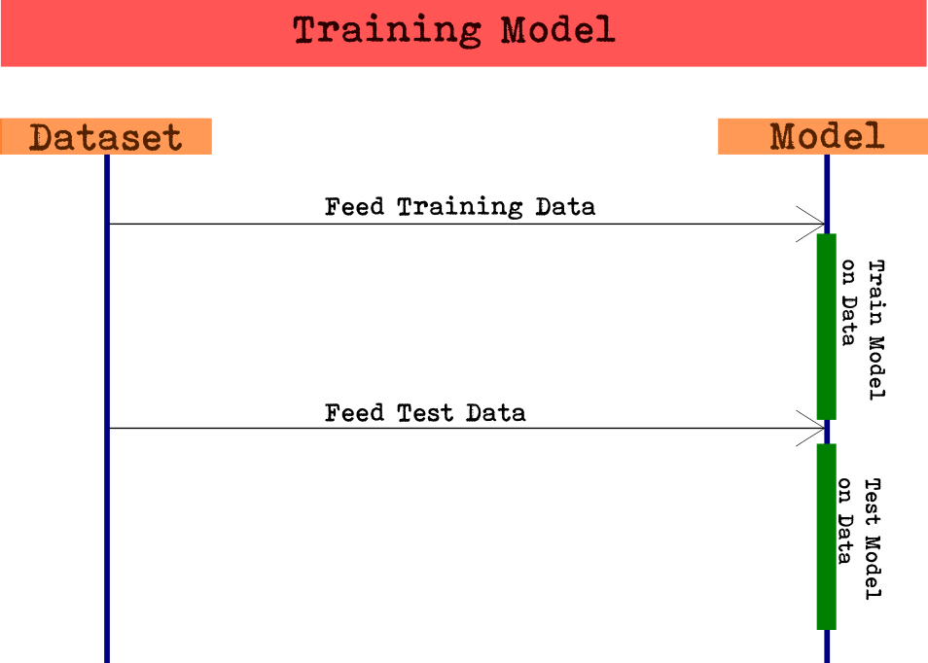
Sequence Diag. for Training Model

Slide 13
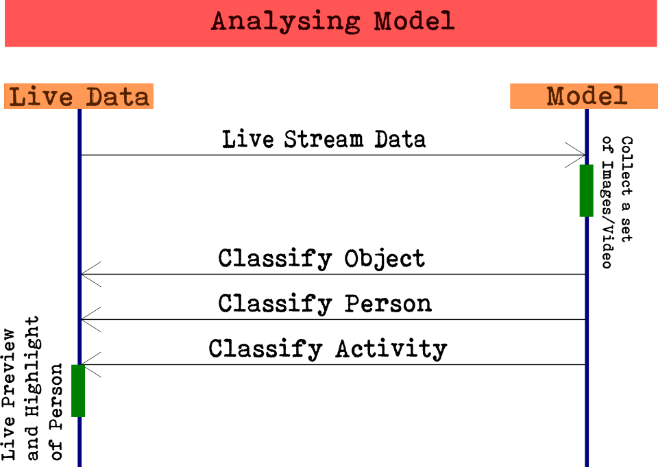
Sequence Diag. for Live Data

Slide 14
Steps
Object Detection
Person Classification (With unique person identity)
Pose Classification
Activity Classification

Slide 15
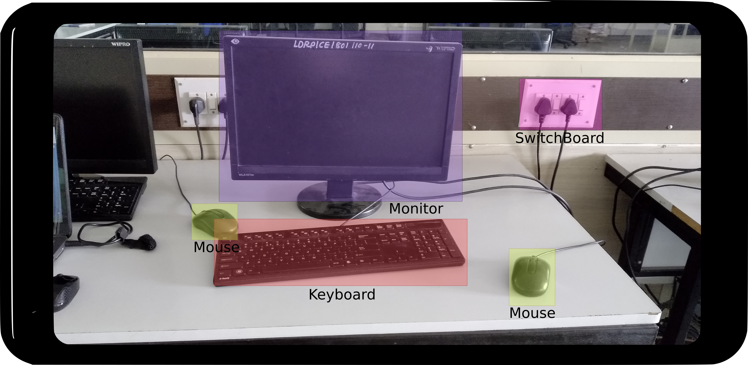
Step 1 : Object Classification

Slide 16
How is it done?
Make a tensorflow model for object classification.
Upload it as a custom model to firebase ML Kit.
Integrate with Android App as a analysis Use Case for CameraX
Upload Live Video to Firebase (set of images maybe) and get object category and its location on the image.
Make a boundary over the object sent by our model.

